Slide 1
OpenStack QA
May 2018
Project Update, OpenStack Summit Vancouver
Ghanshyam Mann,
IRC- gmann, gmann@ghanshyammann.com

Slide 2

Notes:
Insert Mascot right

Slide 3

What is OpenStack QA??
Official Mission Statement:
“Develop, maintain, and initiate tools and plans to ensure the upstream stability and quality of OpenStack, and its release readiness at any point during the release cycle.”
Notes:
Insert Mascot right

Slide 4
What is OpenStack QA??
Tempest
Devstack
Patrole
Grenade
devstack-tools
devstack-plugin-ceph
devstack-plugin-container
openstack-health
os-testr
Stackviz
bashate
coverage2sql
eslint-config-openstack
os-performance-tools
devstack-vagrant
devstack-plugin-cookiecutter
karma-subunit-reporter
tempest-plugin-cookiecutter
tempest-lib (Deprecated)
Hacking
tempest-stress
Notes:
Insert Mascot right

Slide 5
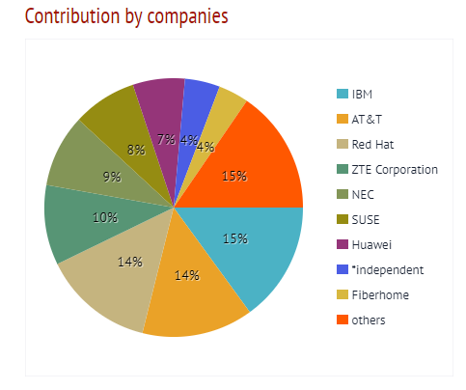
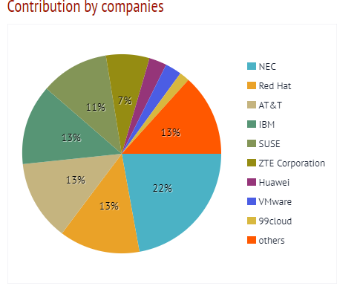


What is OpenStack QA??
CONTRIBUTOR STATS: (Queens Cycle) - http://stackalytics.com/?metric=marks&release=queens&module=quality%20assurance-group
Commits: Total 661 Reviews: Total 2660 Bugs/Emails
Current Open Requests:
Notes:
Insert Mascot right

Slide 6
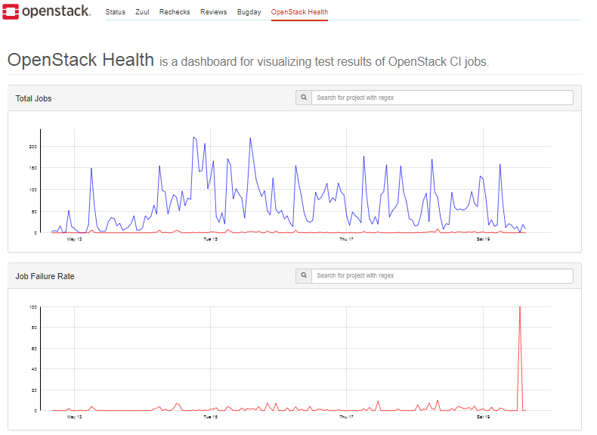
What is OpenStack QA??
Things we do:
Community driven approach to QA
Serve the OpenStack community
Drive testing best practices
Maintain test tools and frameworks
Keep the gate running smoothly
Support interoperability testing efforts
Cross Community collaboration on testing tools etc
Open for new testing ideas/projects
Notes:
Insert Mascot right

Slide 7
OpenStack Queens Features
Tempest Stable APIs
All Service clients
Credential providers
Test base class
Tempest Plugins Goal
https://governance.openstack.org/tc/goals/queens/split-tempest-plugins.html
https://docs.openstack.org/tempest/latest/plugin-registry.html
ZuulV3 migration
Devstack base job
Tempest base job
Grenade base job : In-Progress
More coverage for new features and API

Slide 8
OpenStack Queens Features
Patrole:
Switch role using contextmanager
More test coverage.
Removal of identity v2.0 API tests
devstack-plugin-container
Installation of container engine on Devstack.

Slide 9
OpenStack Rocky
Zuul v3 native jobs
More Stable interfaces for Tempest plugins
Organising Deprecated APIs testing in Tempest
Clean up of scenario tests
Patrole stable release
RBAC Testing for multi policies

Slide 10
Beyond Rocky
Extreme testing (HA, fault management etc)
Cross community testing
Upgrade testing with grenade plugins (community goal)
All Stable branch testing in Patrole gate

Slide 11
Cross-Project Work
Zuulv3 migration fro base jobs
Plugins help on fixing the usage and guidlines
Patrole gating for RBAC testing on project side

Slide 12
How to give feedback
Report Bug
Bug Tracking links - https://wiki.openstack.org/wiki/QA
Send mail on ML: openstack-dev@lists.openstack.org with [qa] in subject.
Ping on IRC.
Catch us in PTG.
Forum session:
Users / Operators Feedback on QA
QA Onboarding sessions

Slide 13
How to contribute
TODAY: QA Onboarding sessions, Tuesday, May 22, 2018, 9:50am-10:30am @Level Two - Room 223
Join us in #openstack-qa, Freenode IRC.
PTG: OpenStack QA Room @PTG Sept 10-14, 2018
OpenStack Contributor Guide.

Slide 14
Q&A
Thank you!
openstack
openstack
OpenStackFoundation

